Slide 1
PVM CR’s SCOPE (FOR SIDE PORTED NON-THROUGH DRIVE END-COVER)
September 2018
Notes:
Tip:
Headlines should be set with an initial cap (sentence case) and the rest in lower case. Only product names or acronyms in the headline should begin with a capital letter.

Slide 2
PVM CR’s BACKGROUND
PVM product line is being rationalized and some features are eliminated as below.
PVM pumps with side ports and no auxiliary mounting (position 25 = 0) will be replaced with new product numbers utilizing side port through drive end covers and a cover plate (position 25=1)
Additionally, available options in model code positions 9-10,11, and 13-14 positions have been reduced as explained in the following slides
The new product numbers mentioned above will only comprise of the go-forward options
(see next slide)

Slide 3
MODEL CODE REPLACEMENT
For input Shaft
In all BOM’s at position 9,10
Code 15 will be replaced by 02
Code 17 will be replaced by 05
Code 18 will be replaced by 09
Code 19 will be replaced by 10
For Mounting Flange
In all BOM’s at position 11
Code B will be replaced by A
Code D will be replaced by C
Code F will be replaced by E
Code H will be replaced by G
Code K will be replaced by J
Code E will be replaced by G (only for 74, 81, 98, 106, 131 & 141CC)
For example
Old model code- PVM045ER15BS04AAC28110000A0A
New model code-PVM045ER02AS02AAC28110001A0A
For Port Options
In all BOM’s at position 13,14
Code 03 & 05 will be replaced by 02
Code 04, 08 & 09 will be replaced by 02
For Auxiliary Mounting
In all BOM’s at position 25
Change “0:- NONE TO
1:- AUXILIARY MOUNT COVER PLATE
*Please refer color coding for model code change

Slide 4
INPUT SHAFT (POSITION 9,10)
Old Options | New options
15:- ISO 3019/2 E20N, STRAIGHT KEYED (MODEL 018 AND 028) | 02:- SAE J744-19-1, SAE 19-1, STRAIGHT KEYED (MODEL 018 AND 028)
17:- ISO 3019/2 E25N, STRAIGHT KEYED (MODEL 018,028, 045 AND 057) | 05 :- SAE J744-22-1, SAE B, STRAIGHT KEYED (MODEL 018, 028 AND 045)
18:- ISO 3019/2 E32N, STRAIGHT KEYED, SHORT SPIGOT (MODEL 057, 074, 098, 131 AND 141) | 09 :- SAE J744-32-1, SAE C, STRAIGHT KEYED (MODEL 057, 074, 098, 131 AND 141)
19:- ISO 3019/2 E40N STRAIGHT KEYED SHORT SPIGOT (MODEL 074, 098 AND 131) | 10 :- SAE J744-38-1, SAE C-C, STRAIGHT KEYED (MODEL 074, 098 AND 131)

Slide 5
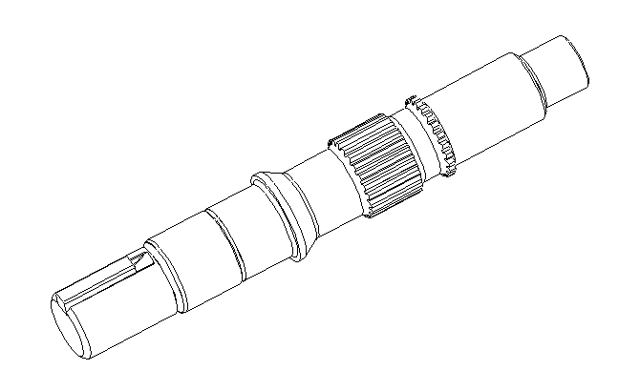
INPUT SHAFT (POSITION 9,10)
OLD OPTION
NEW OPTION
ISO NON-THROUGH DRIVE SHAFT
SAE THROUGH DRIVE SHAFT

Slide 6
MOUNTING FLANGE (POSITION 11)
Old Options | New Options
B:- ISO 3019/2-80A2HW (MODEL 018 AND 028) | A :- SAE J744-82-2 (A 2-BOLT) (MODEL 018 AND 028)
D :- ISO 3019/2-100A2HW (MODELS 018, 028, 045 AND 057) | C :- SAE J744-101-2 (B 2-BOLT) (MODELS 018,028, 045)
F :- ISO 3019/2-125A2HW (MODELS 057, 074, 098,131 AND 141) | E :- SAE J744-127-2(C, 2-BOLT) ( MODELS 057,074, 098, 131 AND 141)
H :- ISO 3019/2-125B4HW (MODELS 057, 074, 098,131 AND 141) | G :- SAE J744-127-4 (C, 4-BOLT) (MODELS 057,074, 098, 131 AND 141)
K :- ISO 3019/2-160B4HW (MODEL 131) | J :- SAE J744-152-4 D, 4-BOLT (MODEL 131)
E :- SAE J744-127-2(C, 2-BOLT) (MODELS 074, 081, 098, 106, 131 AND 141) | G :- SAE J744-127-4 (C, 4-BOLT) (MODELS 074, 081, 098, 106, 131 AND 141)

Slide 7
MOUNTING FLANGE (POSITION 11 E TO G) (FOR 074, 081, 098, 106, 131 AND 141)
ELIMINATED OPTION
GO FORWARD OPTION
SAE MOUNTING FLANGE 2-BOLT
SAE MOUNTING FLANGE 4-BOLT

Slide 8
PORT OPTIONS (POSITION 13,14)
Eliminated Options | Go Forward Option
03:- ISO 6149-1 TUBE PORTS, ISO AUXILIARY PORTS | 02:- SAE J518 FLANGE PORTS, SAE AUXILIARY PORTS
05:- 'G' CODE (BSPP) TUBE PORTS, 'G' CODE AUXILIARY PORTS
04:- ISO 6162 FLANGE PORTS, ISO AUXILIARY PORTS | 02:- SAE J518 FLANGE PORTS, SAE AUXILIARY PORTS
08:- ISO 6162 FLANGE PORTS, 'G' CODE (BSPP) AUXILIARY PORTS
09:- ISO 6162 FLANGE PORTS, SAE AUXILIARY PORTS

Slide 9
MOUNTING FLANGE DRAIN PORT (POSITION 13,14)
ELIMINATED OPTION
GO FORWARD OPTION
MOUNTING FLANGE WITH ISO PORTING
MOUNTING FLANGE WITH SAE PORTING

Slide 10
PORT OPTIONS (POSITION 13,14)
ELIMINATED OPTION
GO FORWARD OPTION
ISO PORTING
SAE PORTING

Slide 11
AUXILIARY MOUNTING (POSITION 25)
Eliminated Option | New Options
0:- None | 1:- Auxiliary Mount Cover Plate

Slide 12
End cover
ELIMINATED OPTION
GO FORWARD OPTION
SIDE PORTED NON-THROUGH DRIVE END COVER
SIDE PORTED THROUGH DRIVE END COVER

Slide 13
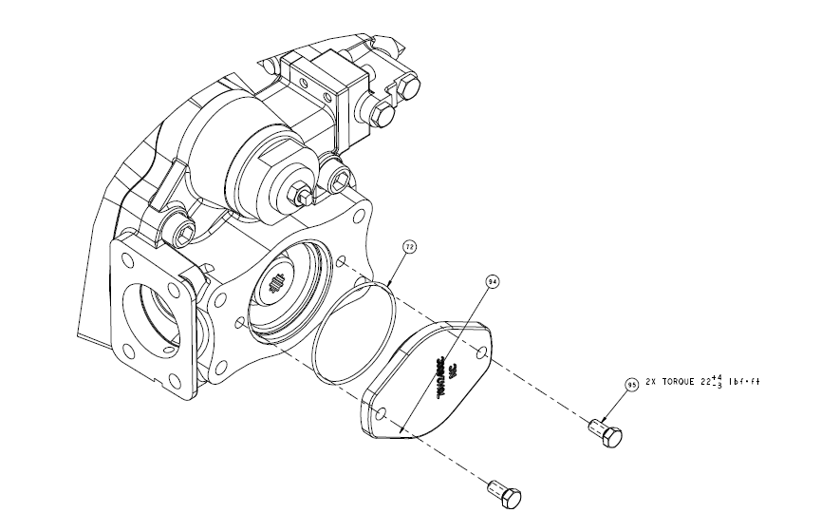
ADDITIONAL ITEMS FOR SIDE PORTED NON-THROUGH DRIVE END-COVER
Following are the additional items for side ported non-through drive Pump:-
Item 72, 104166-152, O-ring, 1 qty
Item 94, 70142-600, Cover plate, 1 qty
Item 95, 16032-606, Screw, 2 qty
72
94
95
A-2196-015(Assembly Tab)

Slide 14
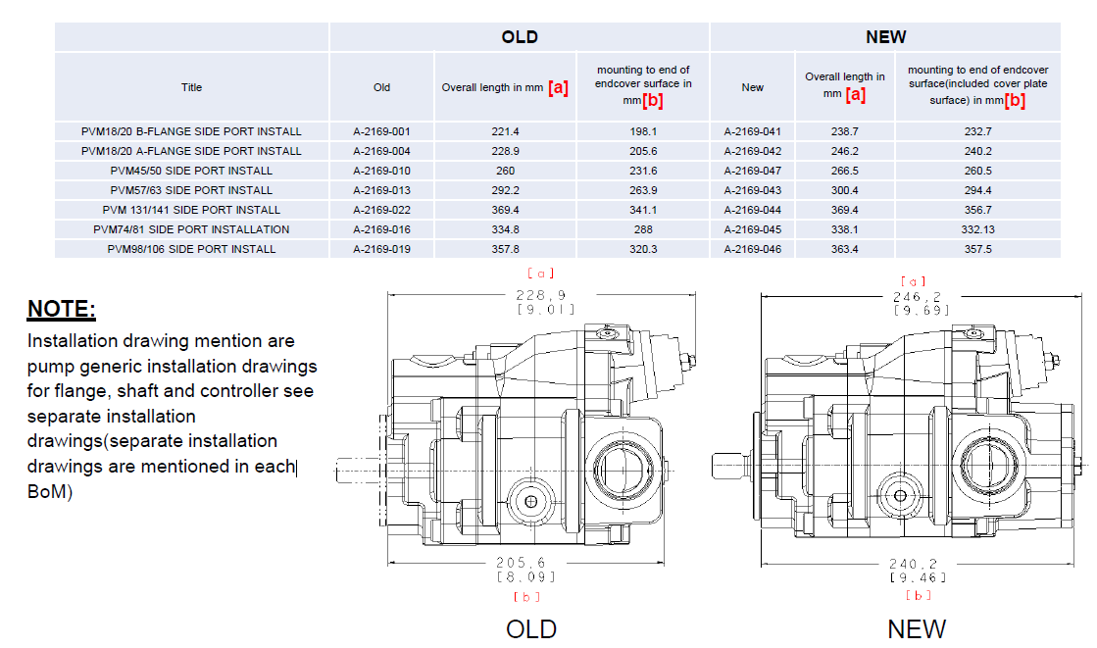
Tabulated Comparison

Slide 15
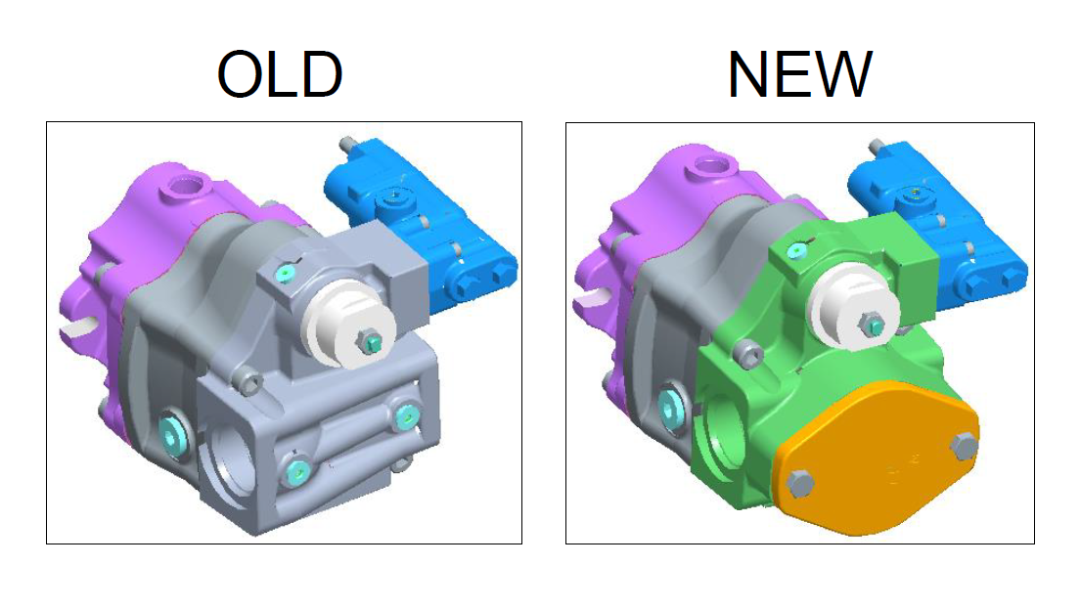
PVM Installation model

